Slide 1
CA2 Individual DAVI(Pt 2) Title:Analysing Student Profiles By: Loh Yip Khai

Slide 2
Nature of the Dataset
Content: The dataset contains student profiles from a business training institute.
Key variables include: STUDENT ID: Unique identifier for each student.
NATIONALITY: Student's nationality.
GENDER: Gender of the student.
GPA: Grade Point Average of the student.
COURSE FEE: Fee for the course.
COURSE FUNDING: Type of funding for the course.
LOCAL and FOREIGN: Indicators of local or foreign students.
Peculiarities: Incorrect values (Y/N) in LOCAL and FOREIGN columns.
Variations in NATIONALITY entries.
Objective: Analyze the relationship between student demographics, course code/course name, and academic performance(GPA).

Slide 3
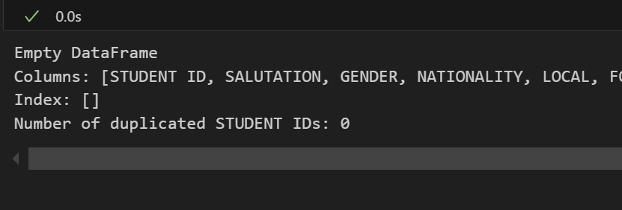



Data Cleansing and Wrangling
Steps taken(Data Cleaning:
Checked for duplicated values based on STUDENT ID.
Cleaned and standardized the NATIONALITY column to remove inconsistencies.
Replaced NaN with an empty string in the LOCAL and FOREIGN columns, and changed incorrect Local/Foreign
Correcting format of ‘DOB’ column, into dd/mm/yyyy

Slide 4
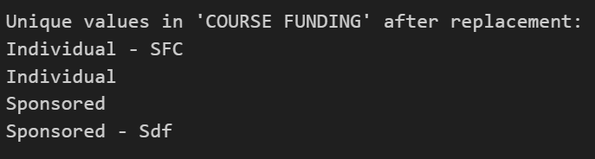

Data Cleansing and Wrangling
Transformations:
Combine Graduate Diploma, Postgraduate Diploma and Postgraduate Diploma/Degree into A New Category called 'Graduate Diploma' Category
Grouped ‘COURSE FUNDING ‘ column to Individual – SFC, Individual, Sponsored, and Sponsored – Sdf categories

Slide 5


Data Cleansing and Wrangling
Create a new Column called Age(at course completion) and Grouped ages into broader categories.
Created a new column called CourseName and CourseCode

Slide 6
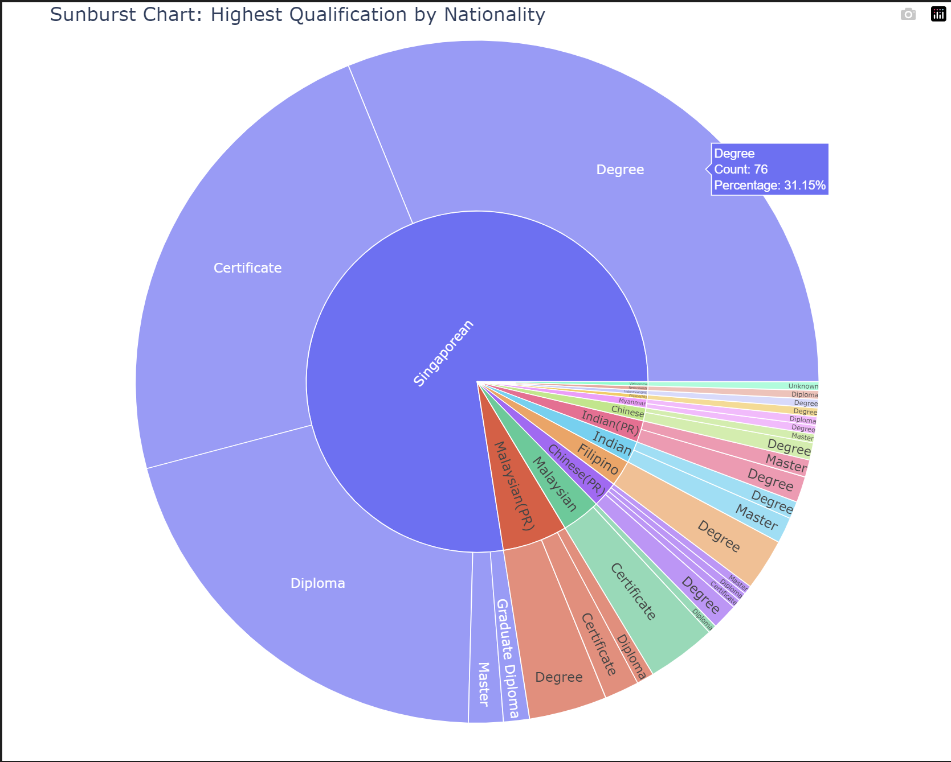
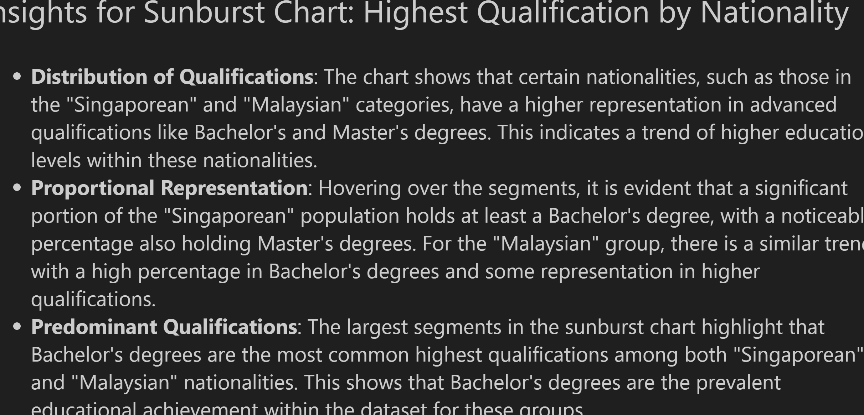
Sunburst Chart

Slide 7
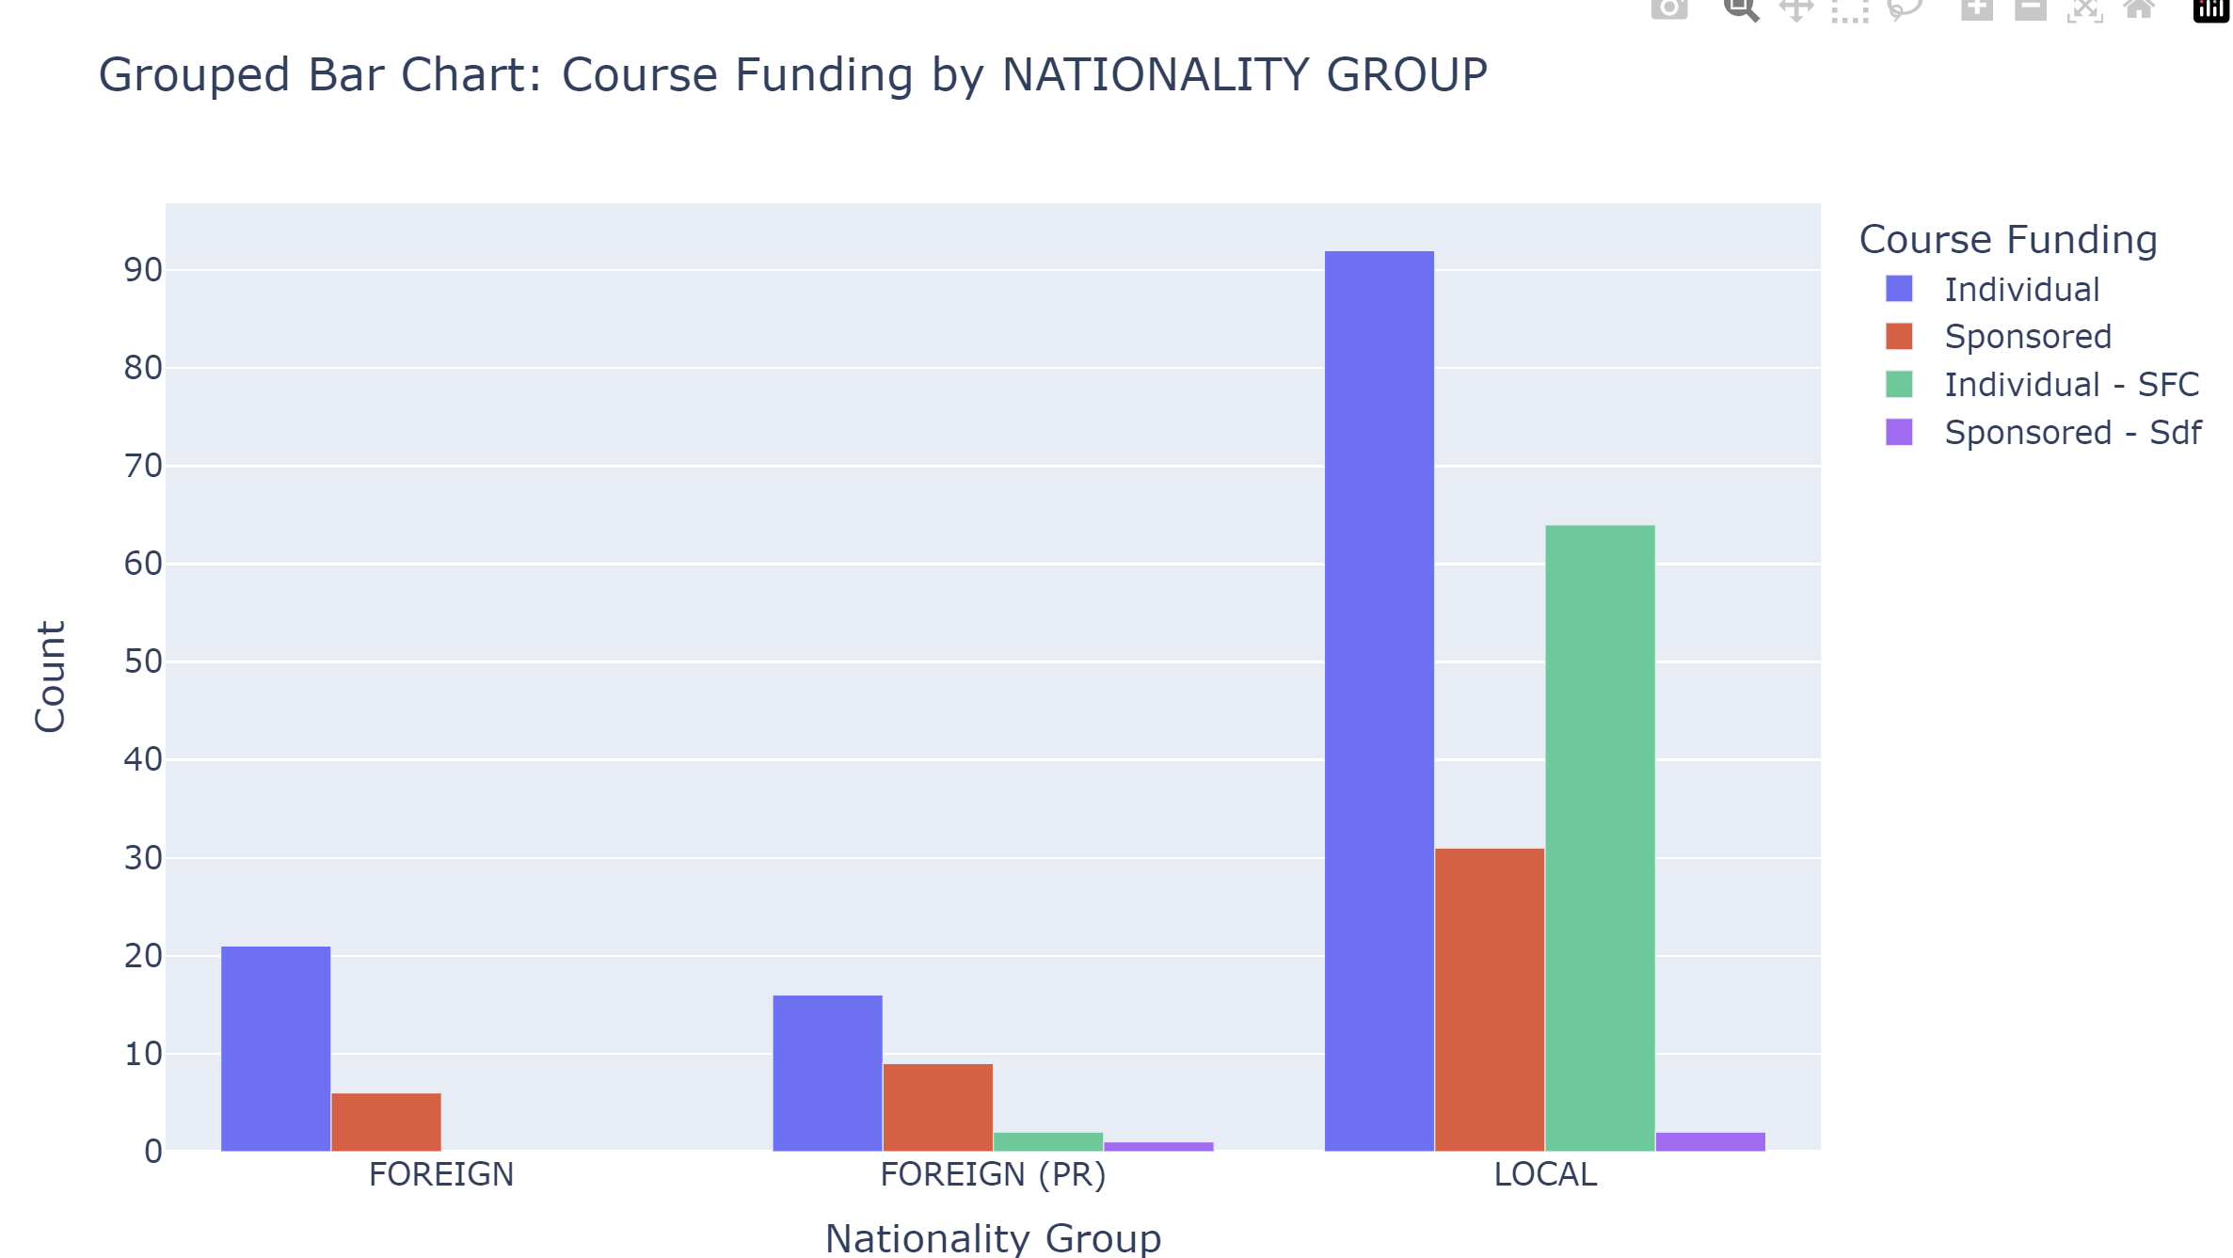
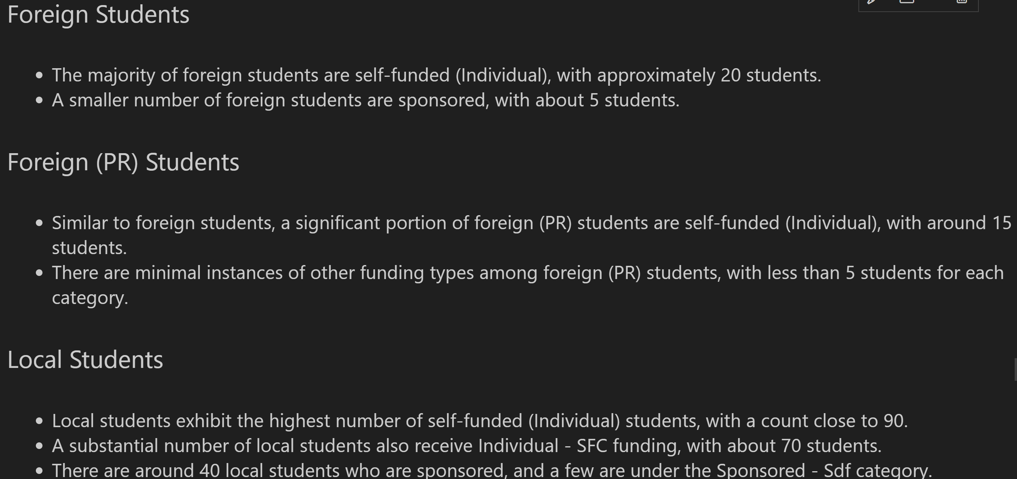
Grouped Bar Chart (By Nationality)

Slide 8
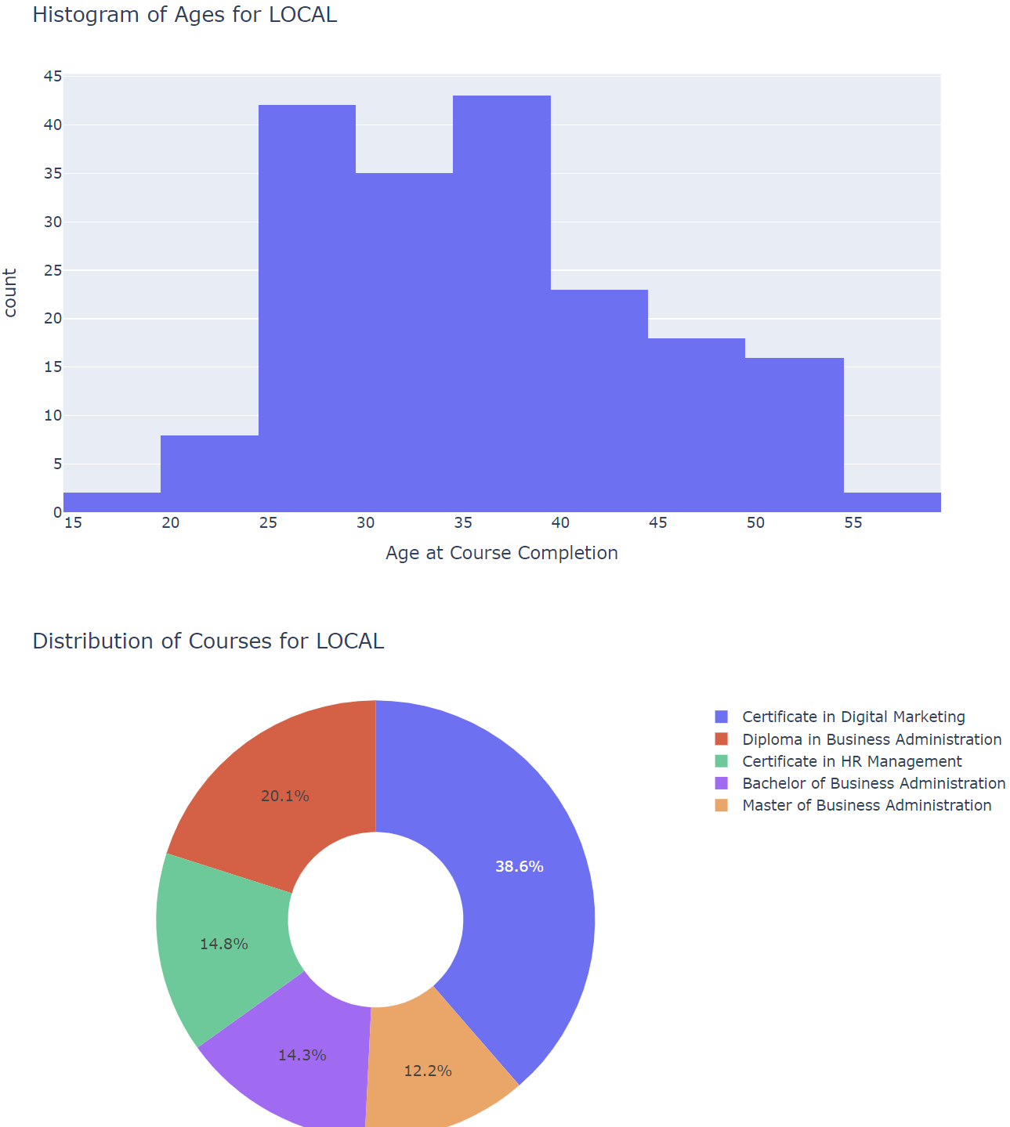
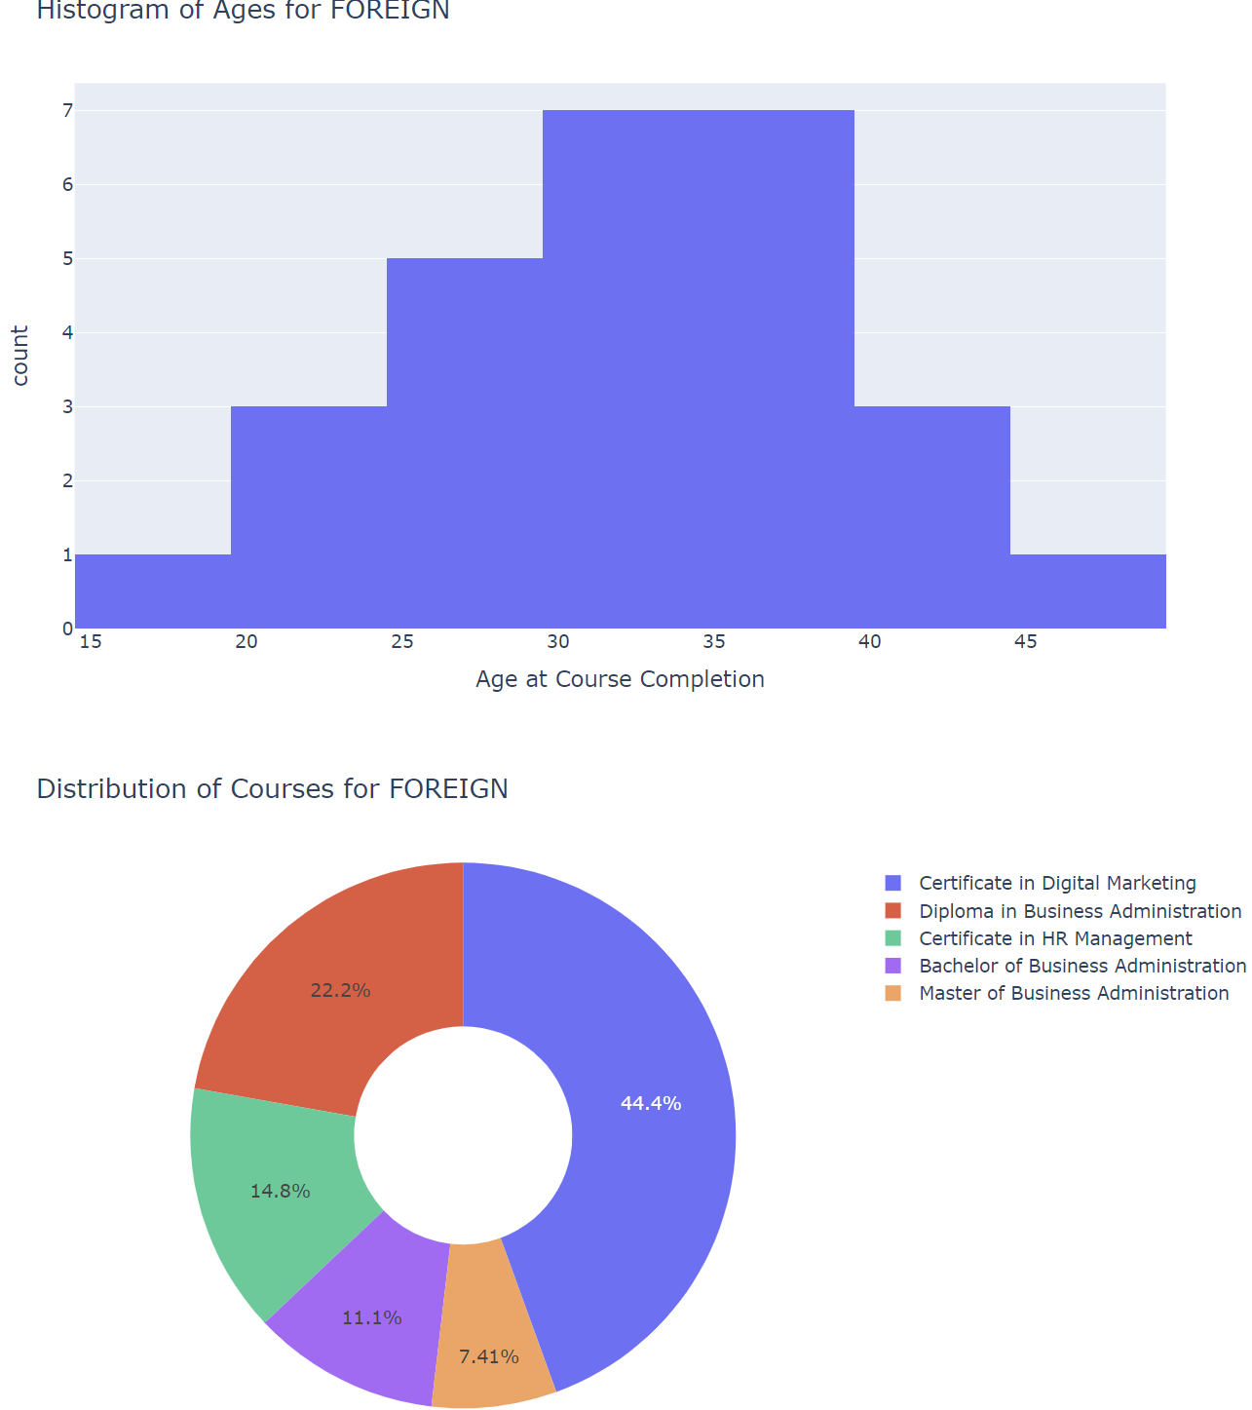
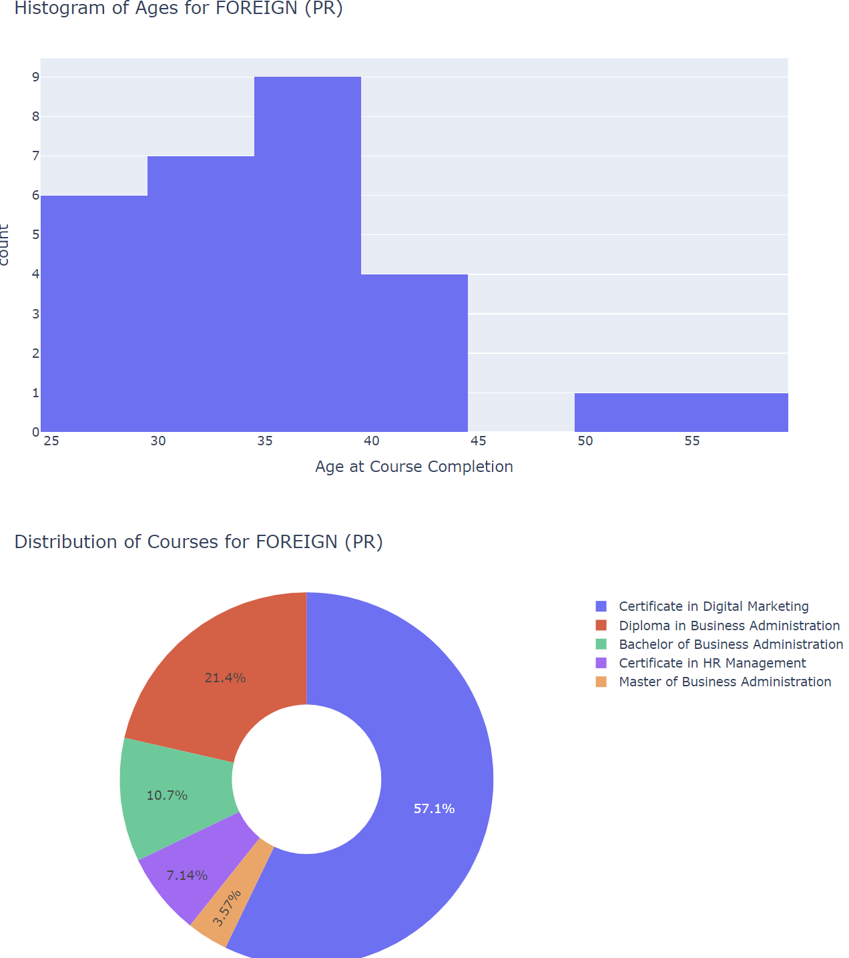
Histogram and Donut By L/F/F(PR)

Slide 9
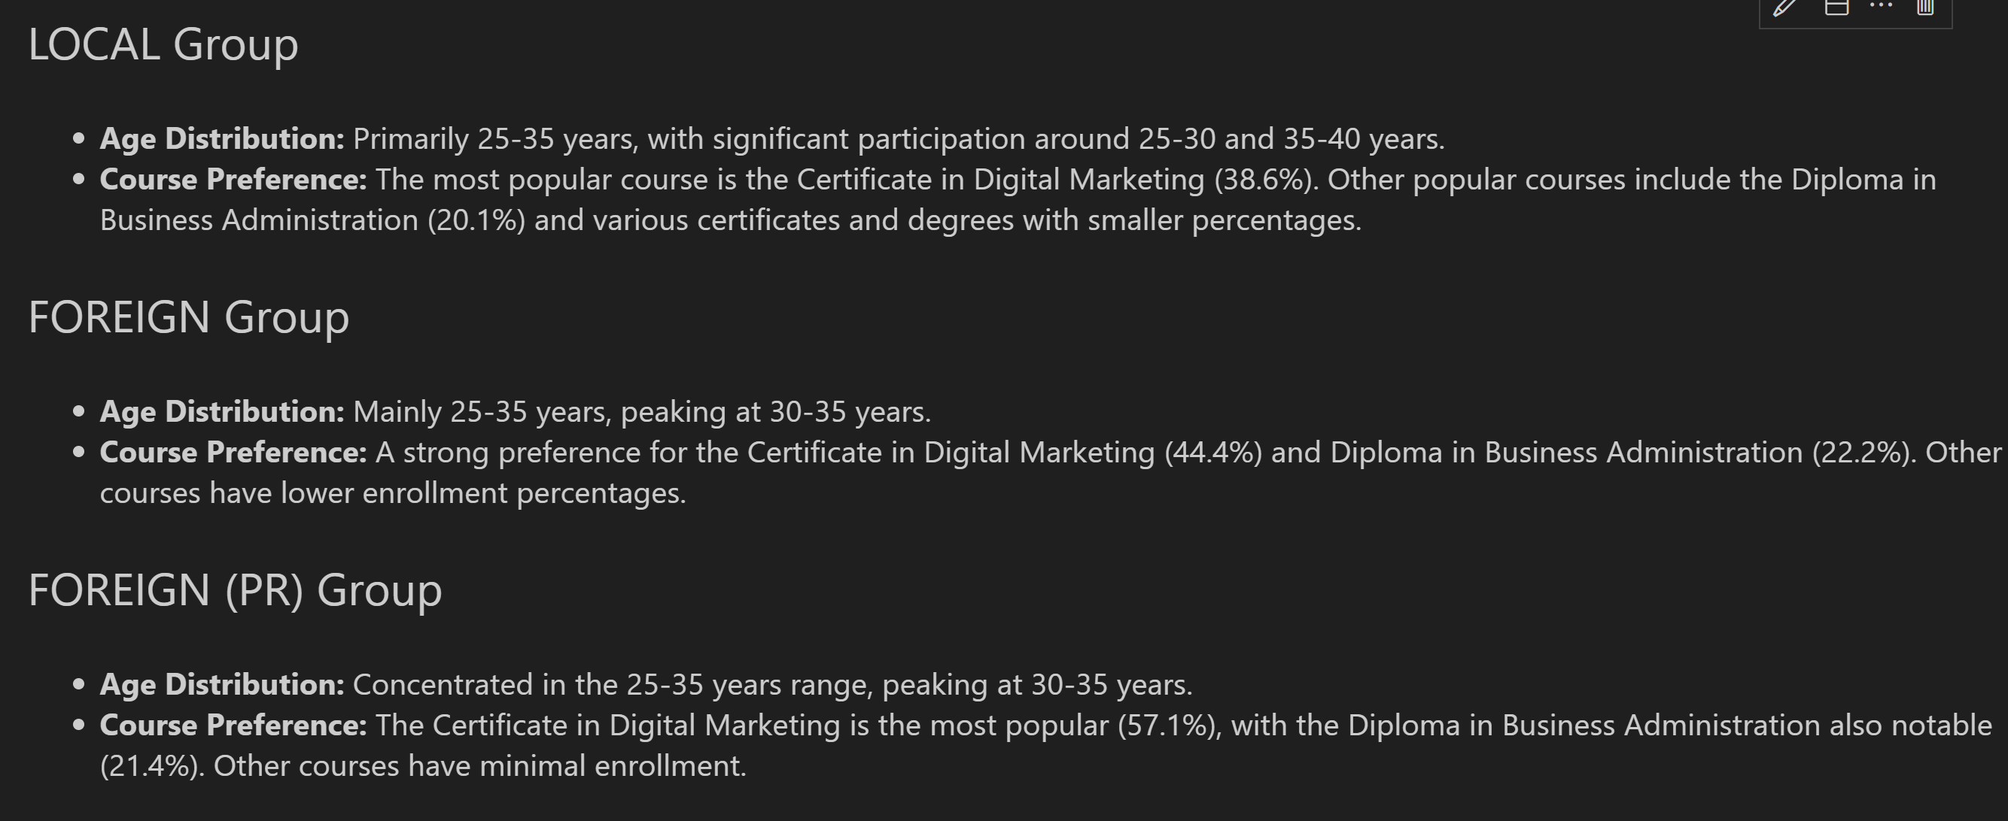
Insights on Plotly Dash Graphs

Slide 10
Reccomendation
Financial concerns vary across age groups, with older students often needing more substantial support due to additional responsibilities.
Nationality also impacts financial needs, as international students face higher tuition fees and living expenses. Additionally, individual funding is the highest percentage of funding for both foreign and local students, indicating a reliance on personal financial resources.
Develop Tailored Financial Aid Programs
Create flexible financial aid packages that address the specific needs of different age groups and nationalities:
Nationality-Specific Support:
Offer tailored financial aid for international students to help with higher tuition and living expenses, including specific scholarships and grants.

